Slide 1
INSIDIA
STYLE GUIDE

Slide 2
SHAPE GUIDE

Slide 3
There are 2 different shape design styles we’ll be using...
ALLY
TEAM
ENEMY
TEAM
(Cap’s Team)

Slide 4


Slide 5


Slide 6
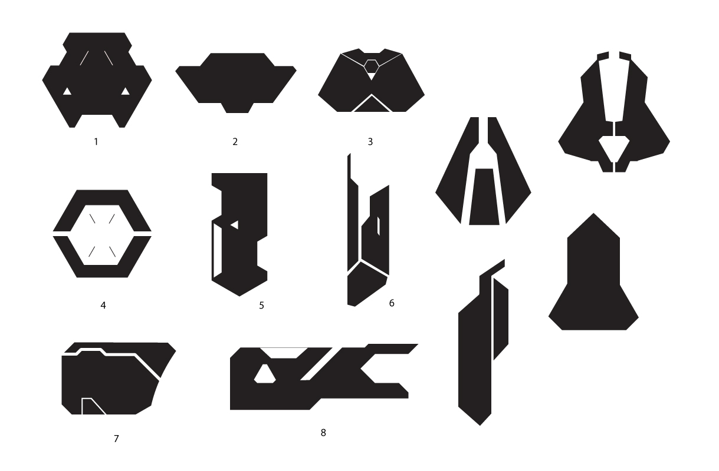
Enemy Complex Shapes

Slide 7
Dinosaur Models
Textures
SHAPE
GUIDE
Props
HUD/Interface
Environment
Design

Slide 8
CHARACTER DESIGN

Slide 9
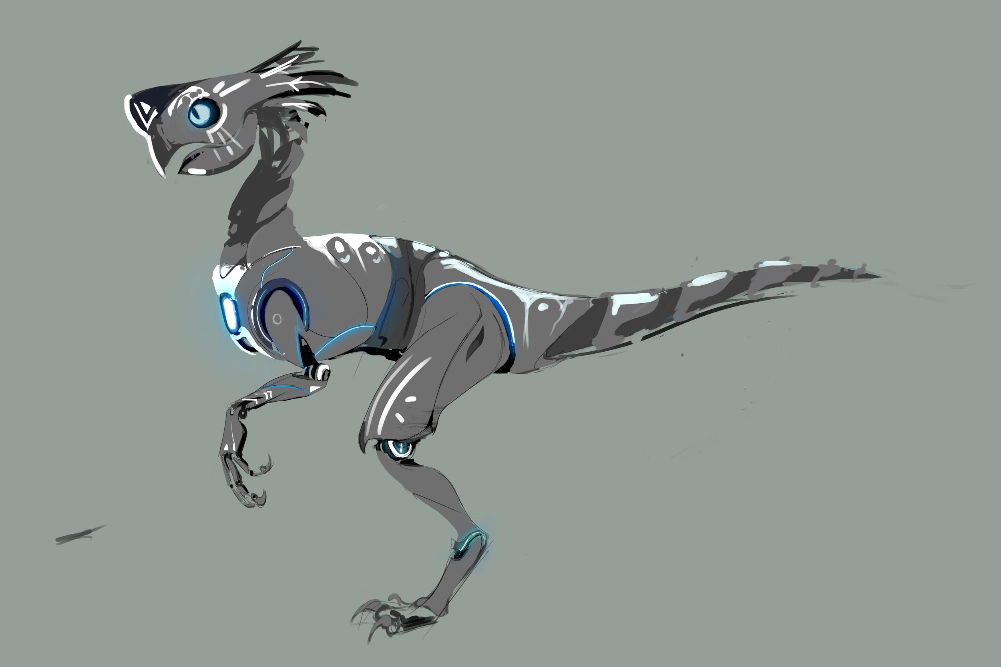
ALLY TEAM CONCEPT

Slide 10
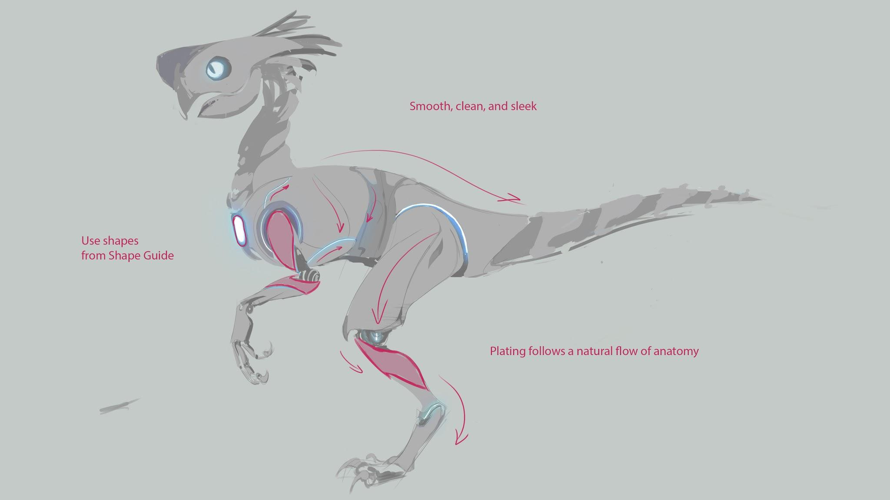

Slide 11

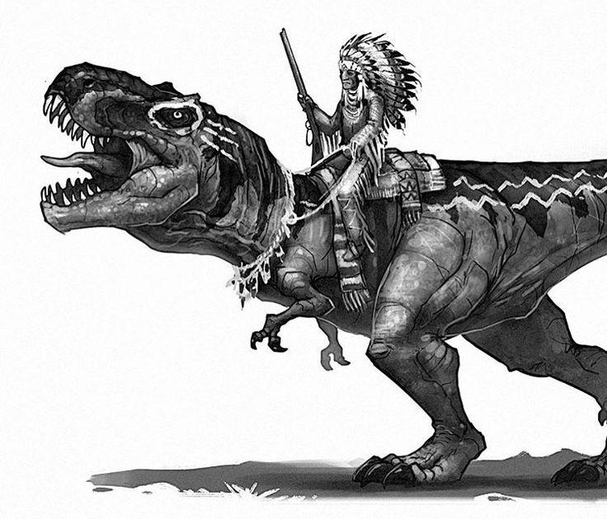
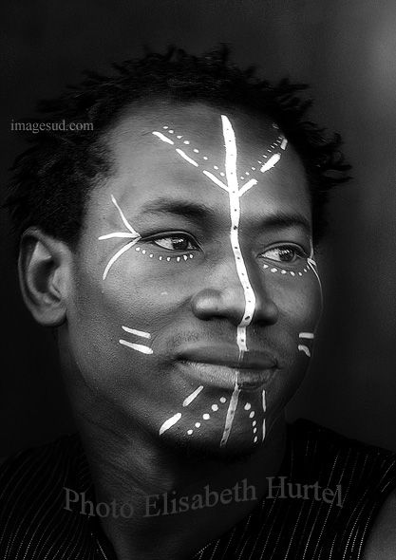
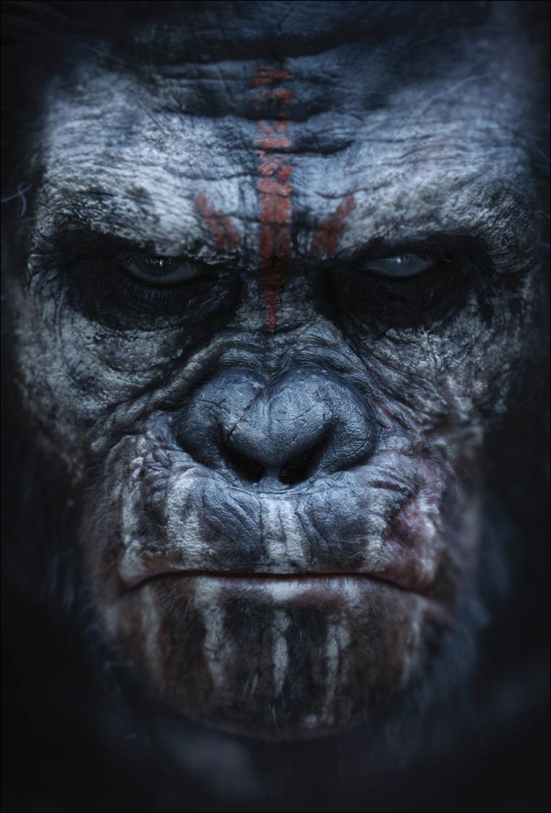
WAR PAINT
*Keep it simple!

Slide 12
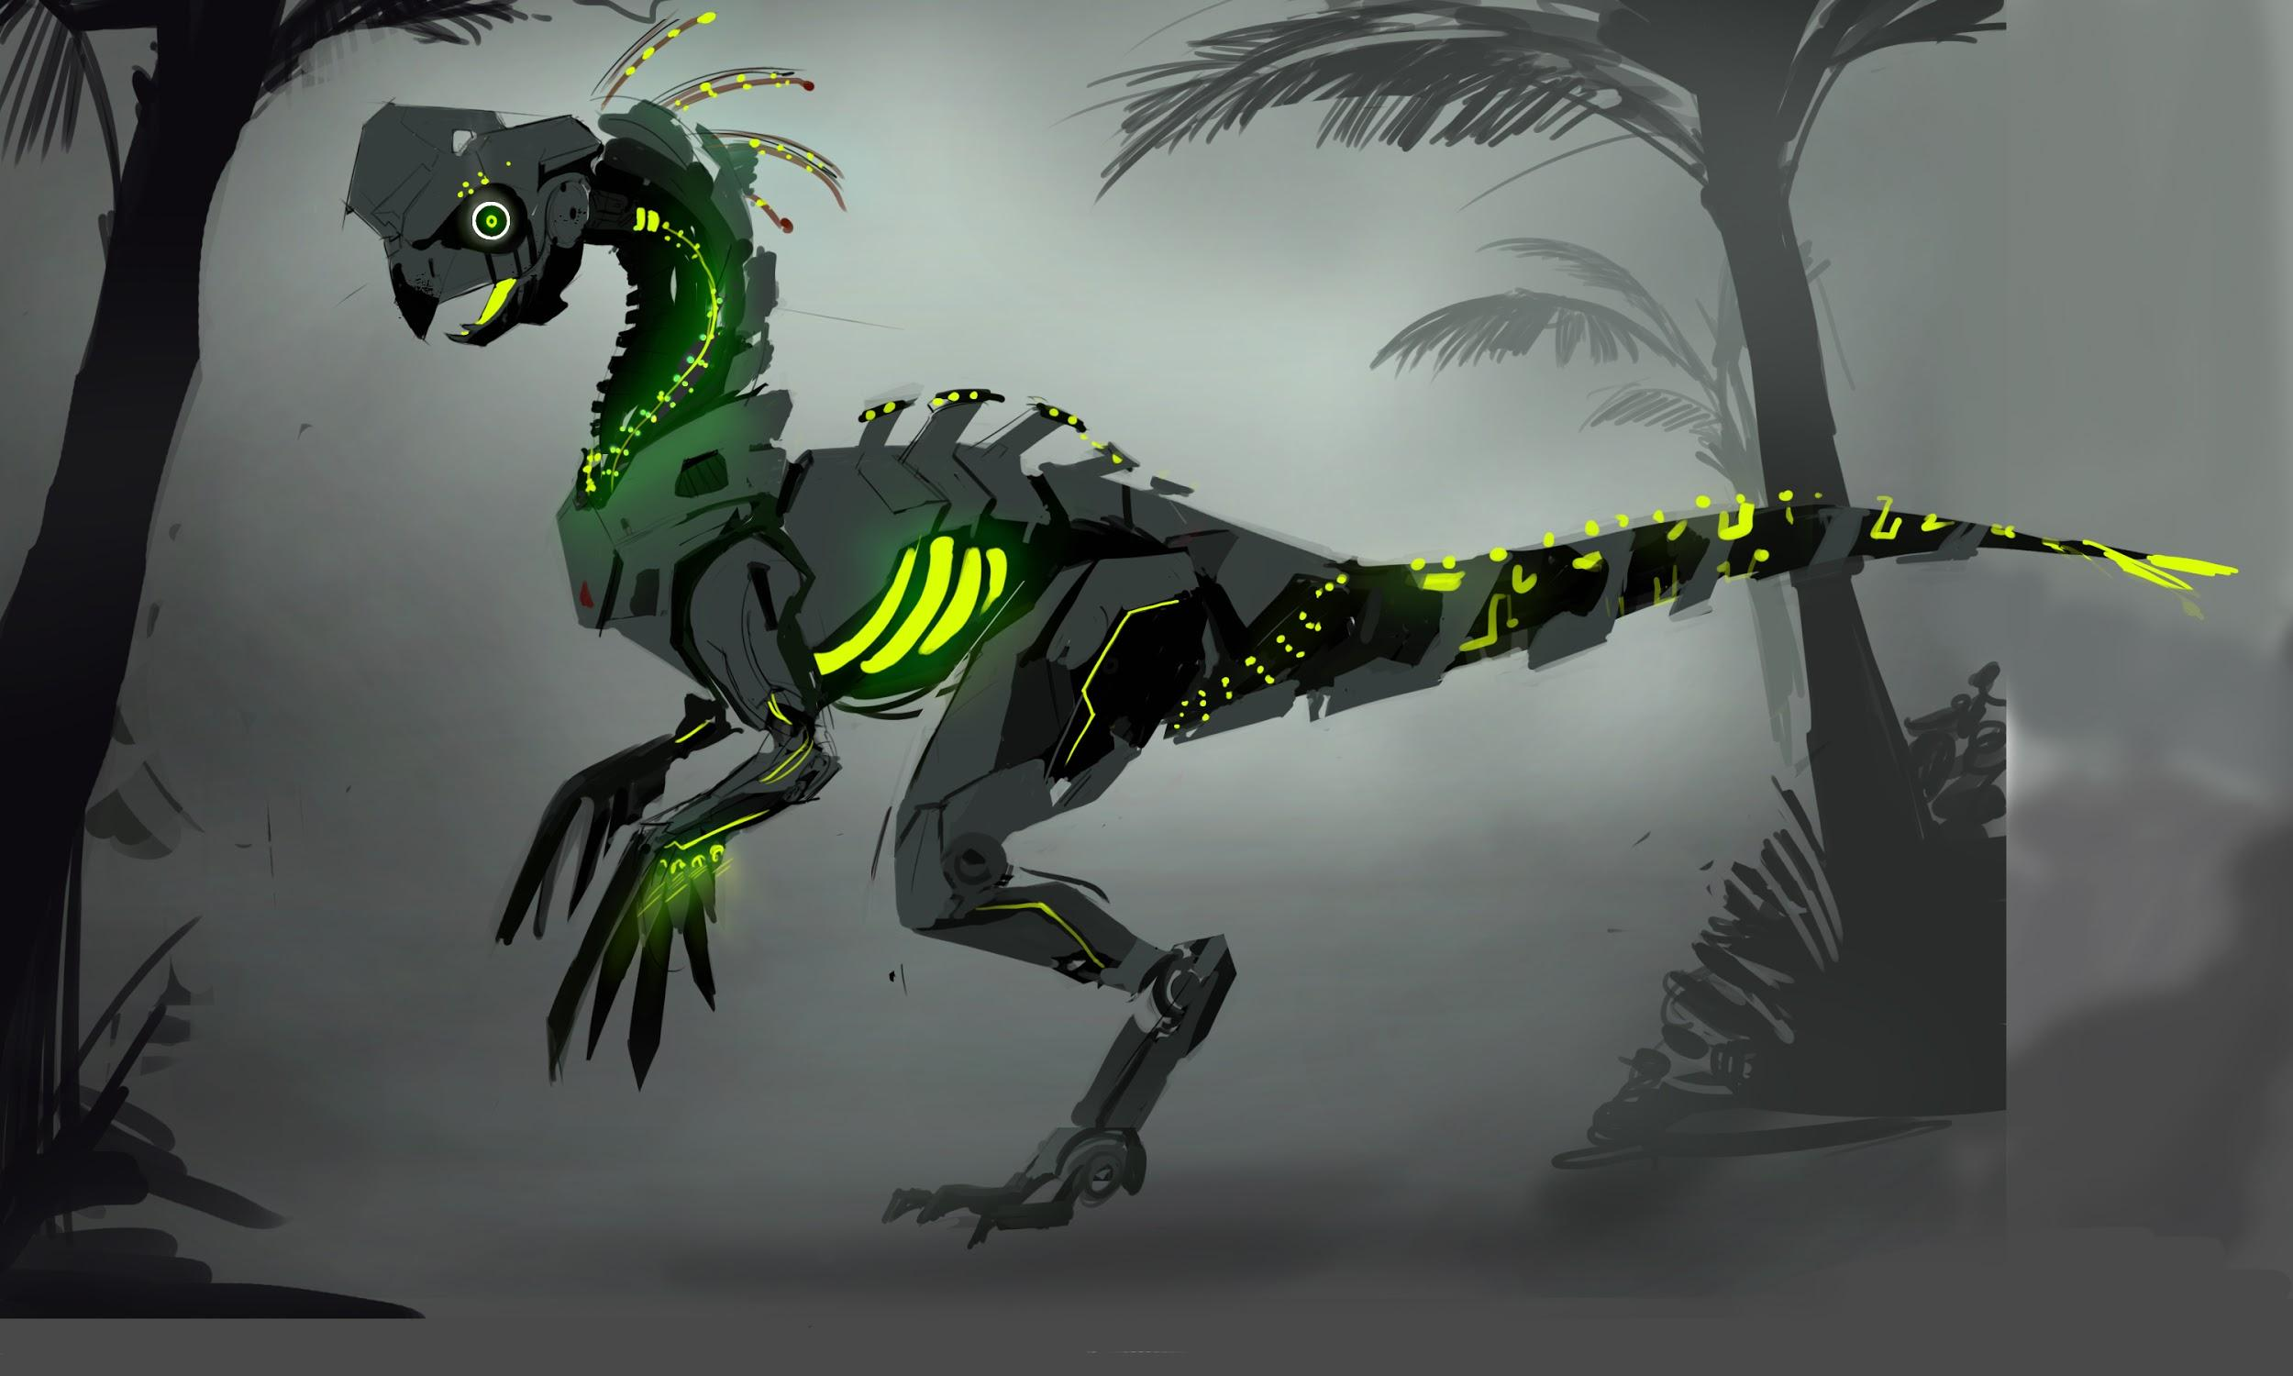
ENEMY TEAM CONCEPT

Slide 13
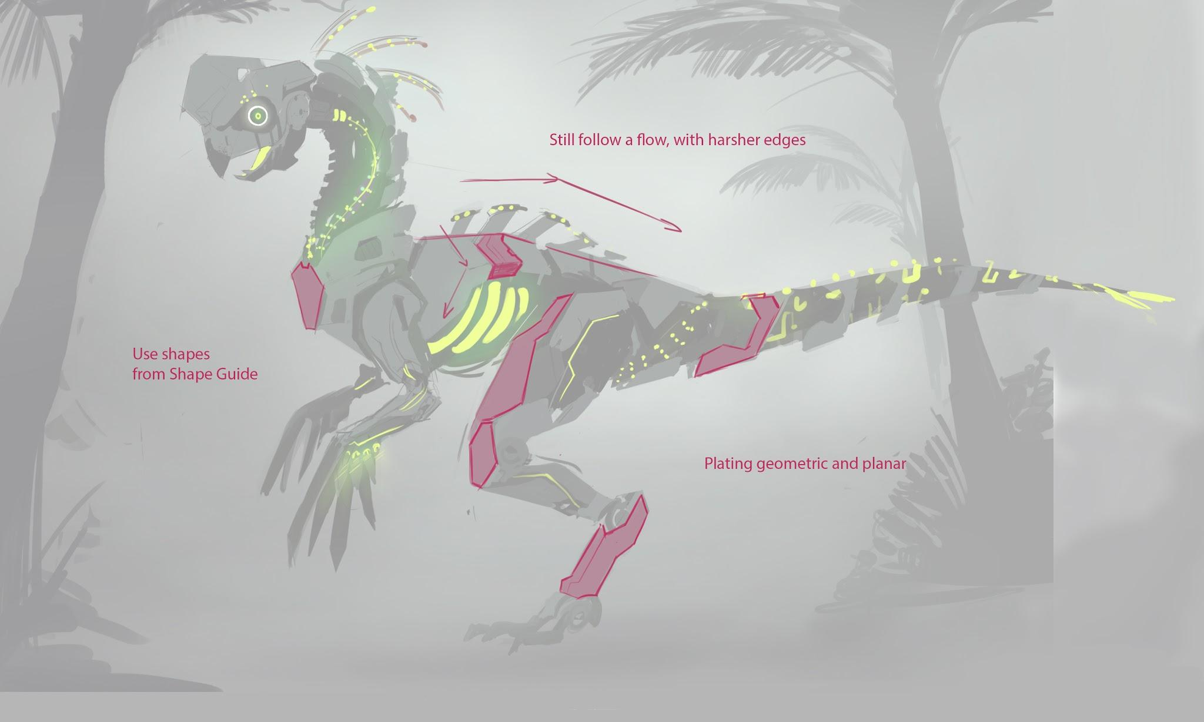

Slide 14
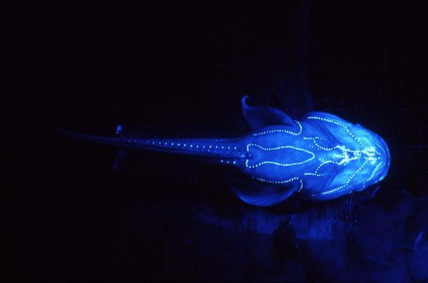
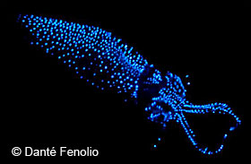
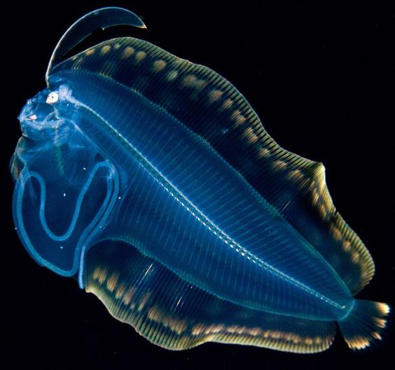
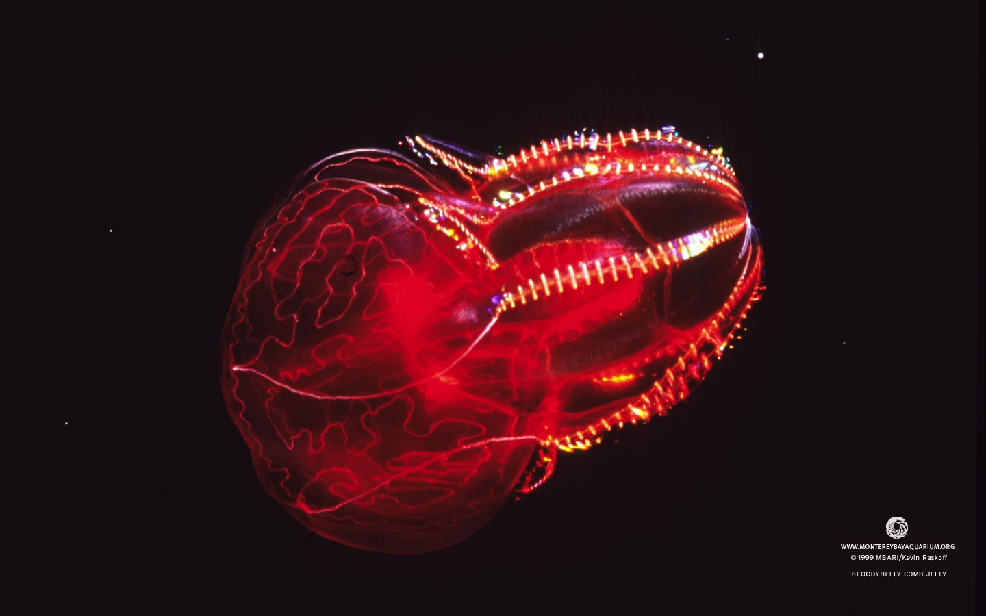
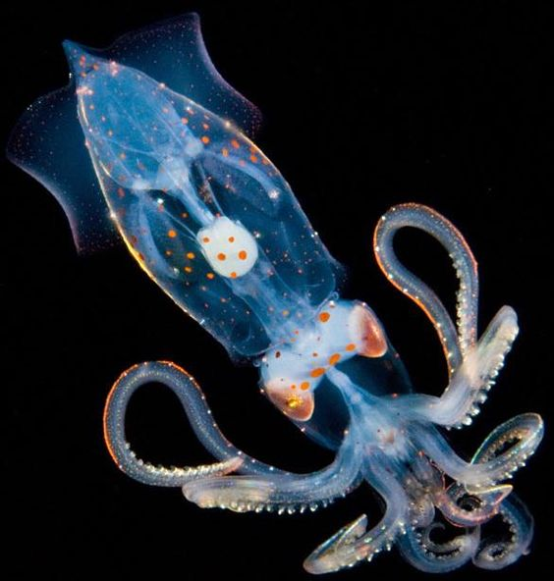
Design the glow lights to look like deep sea creatures

Slide 15
ENVIRONMENT

Slide 16
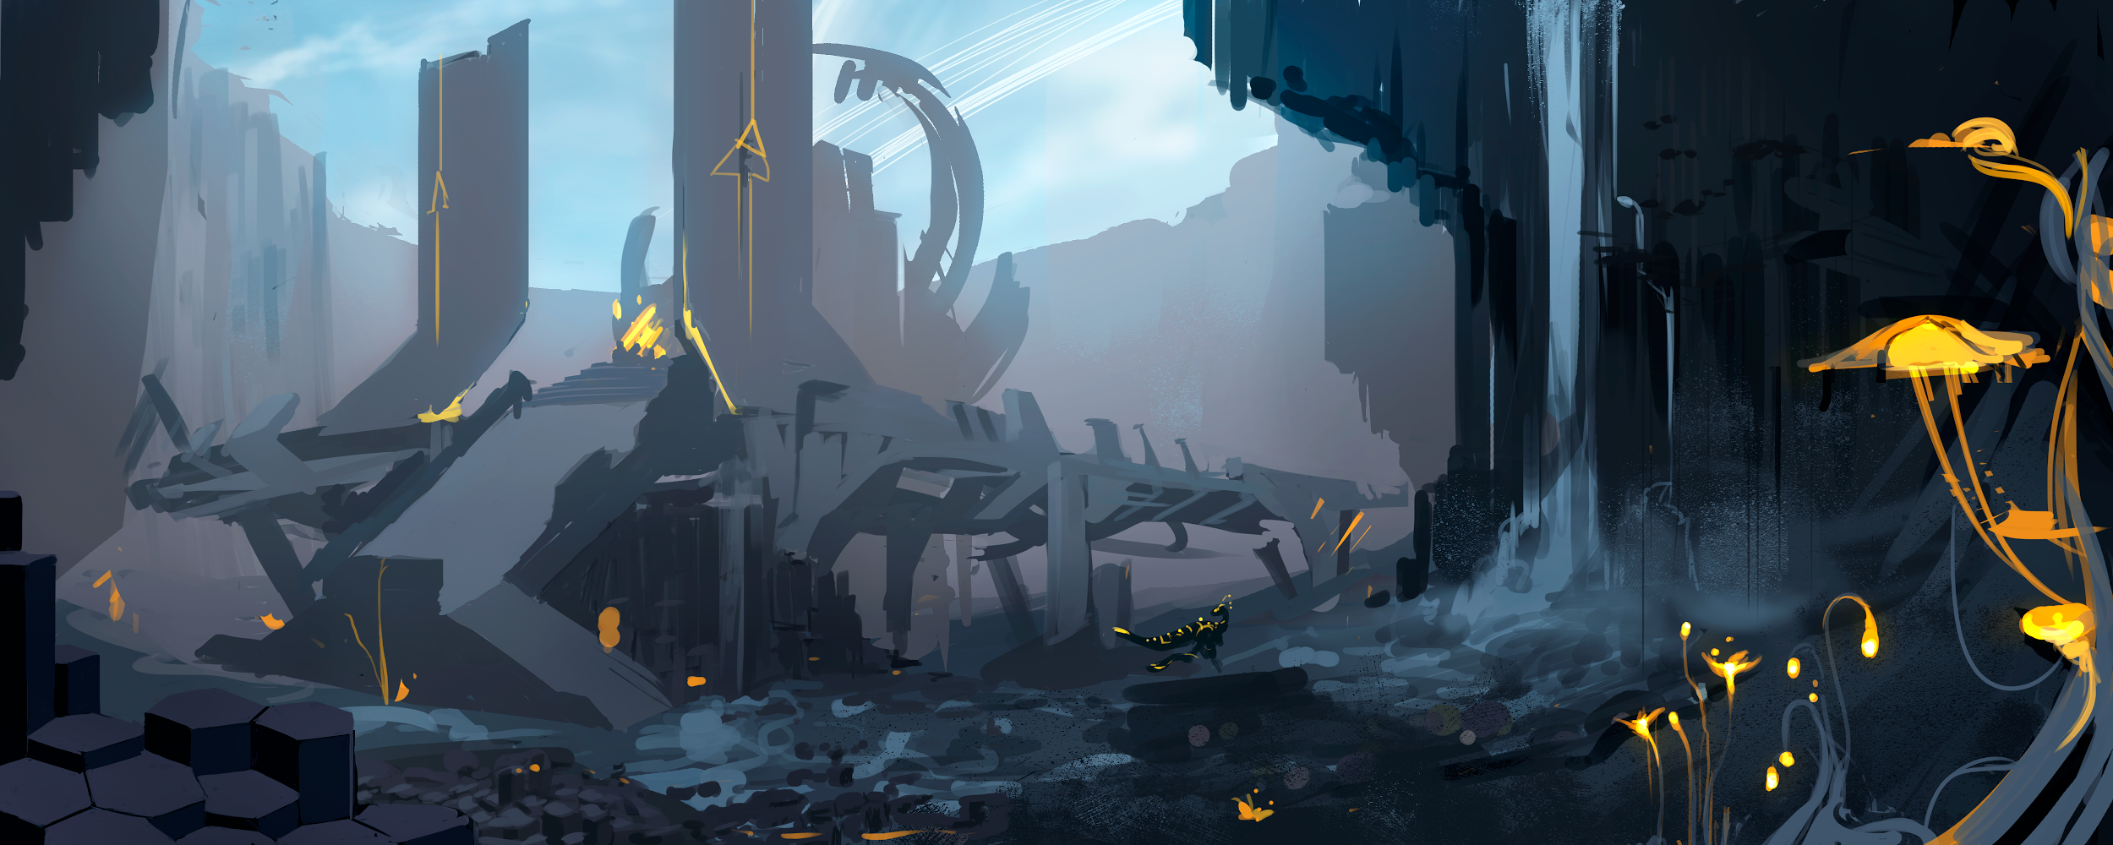
Environment Concept Art
by Jared Mathews

Slide 17
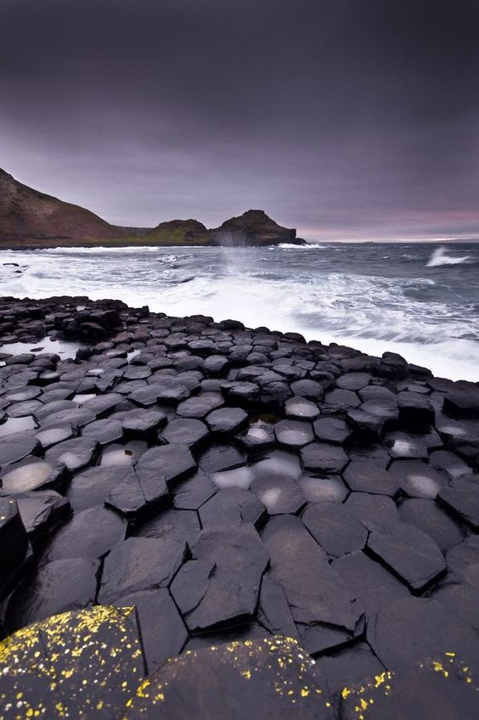
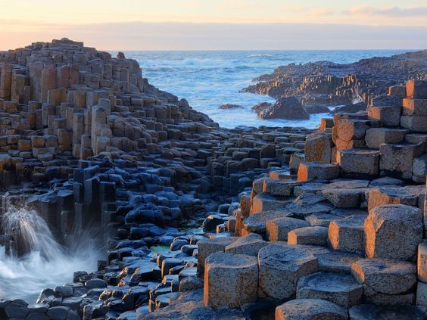
ENVIRONMENT INSPIRATION

Slide 18

Iceland
Black Basalt Rock

Slide 19


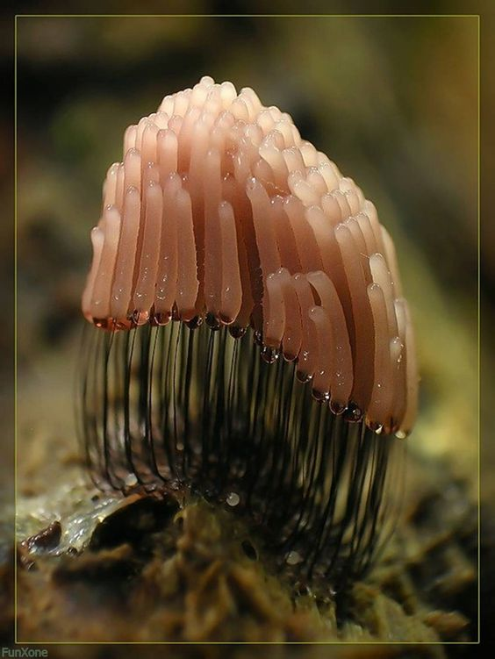
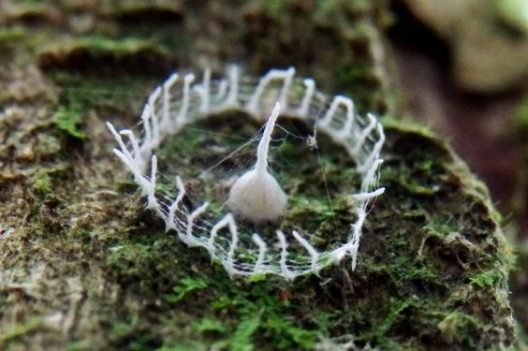

Slide 20
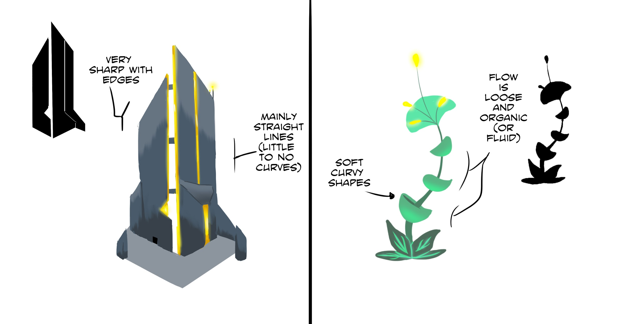
Drawing by Justin Klosinski

Slide 21
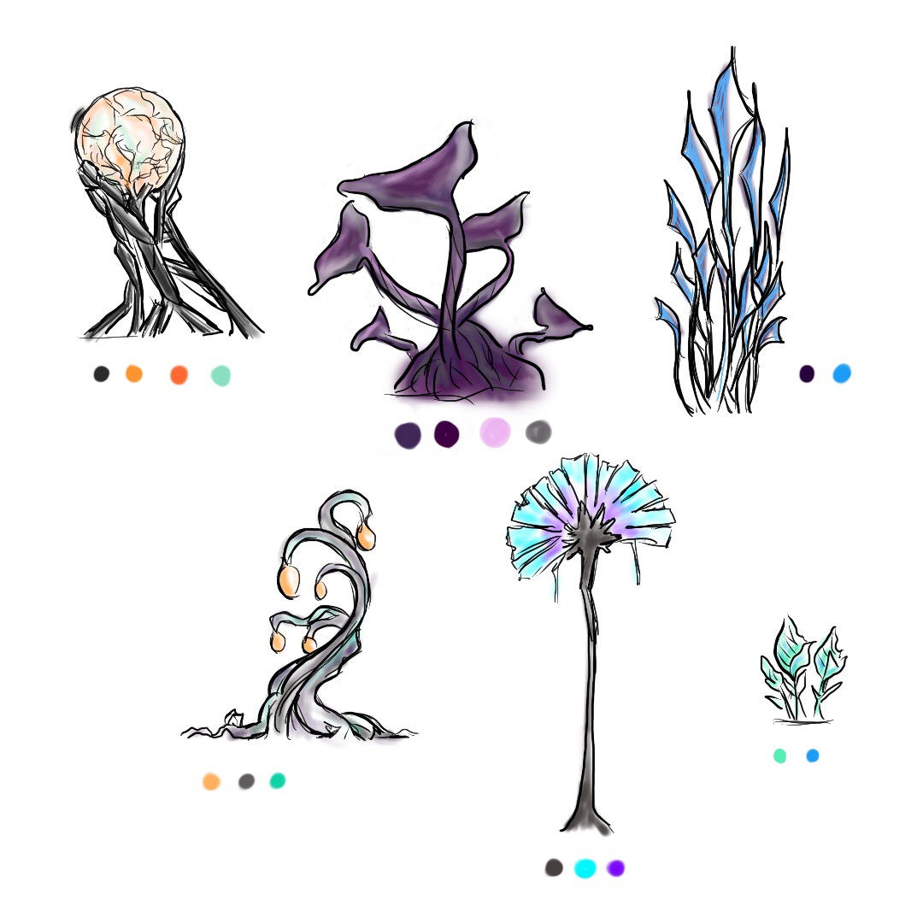
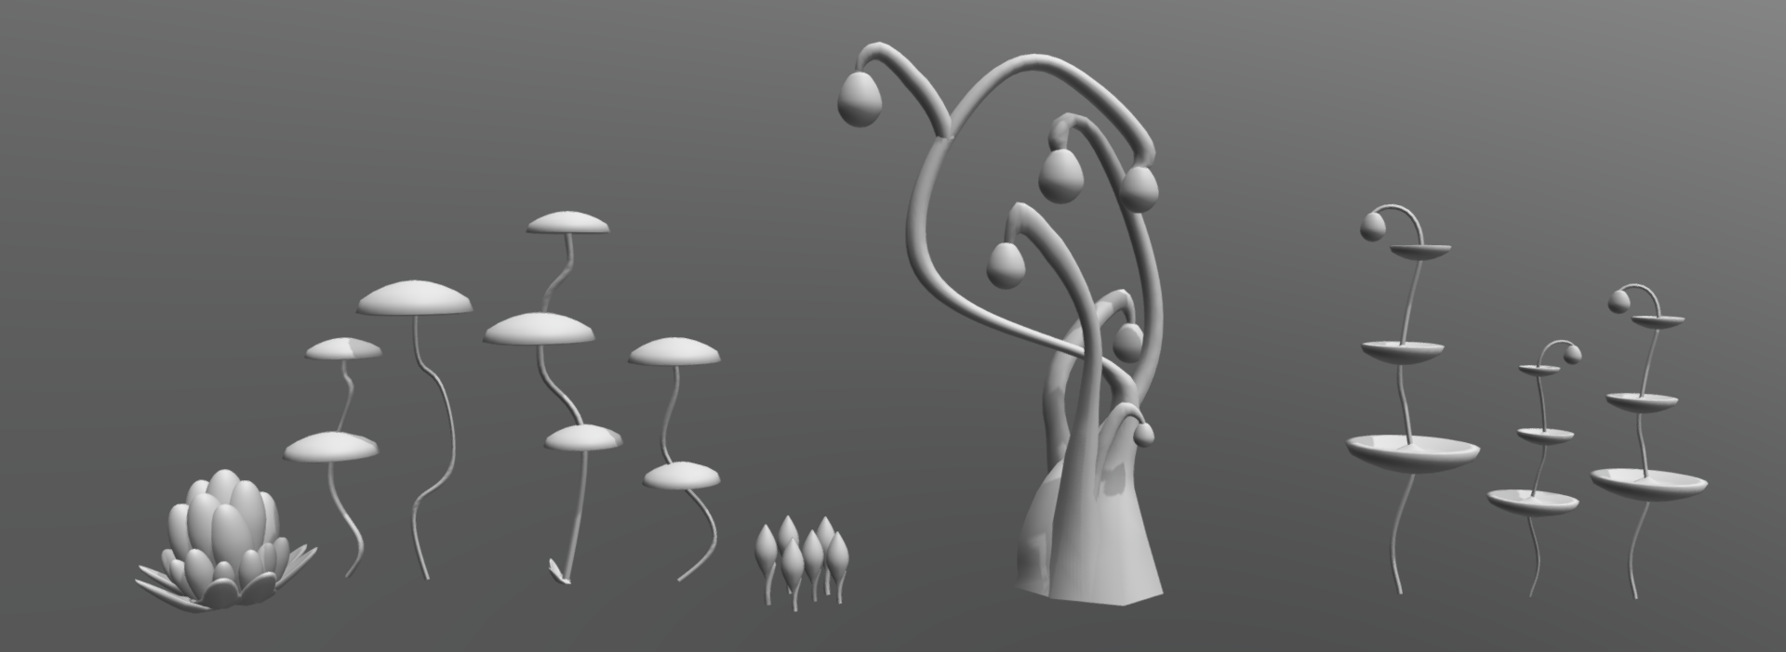
PLANTS
Sketchfab Link
Drawing & Models
by Rachel Burrows

Slide 22
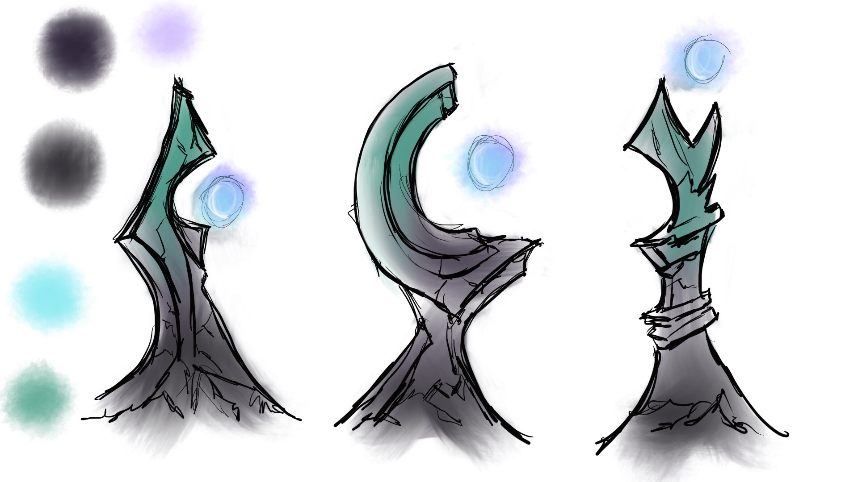
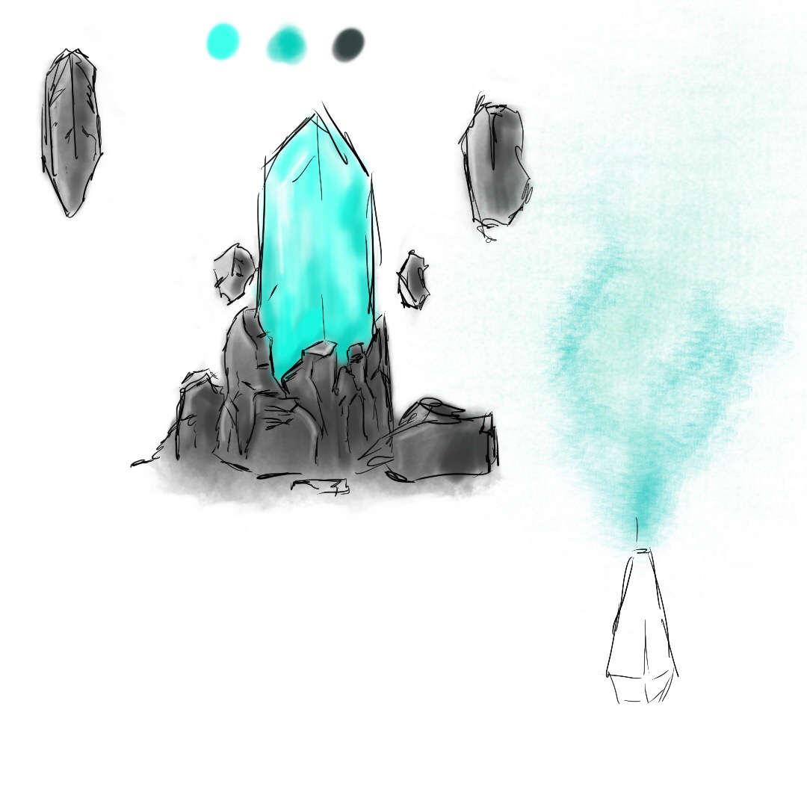
RELIC CONCEPTS

Slide 23
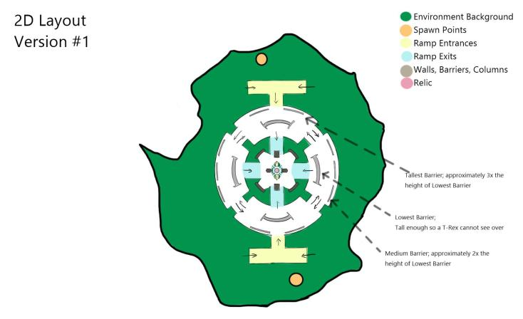

Slide 24
WEAPONS

Slide 25
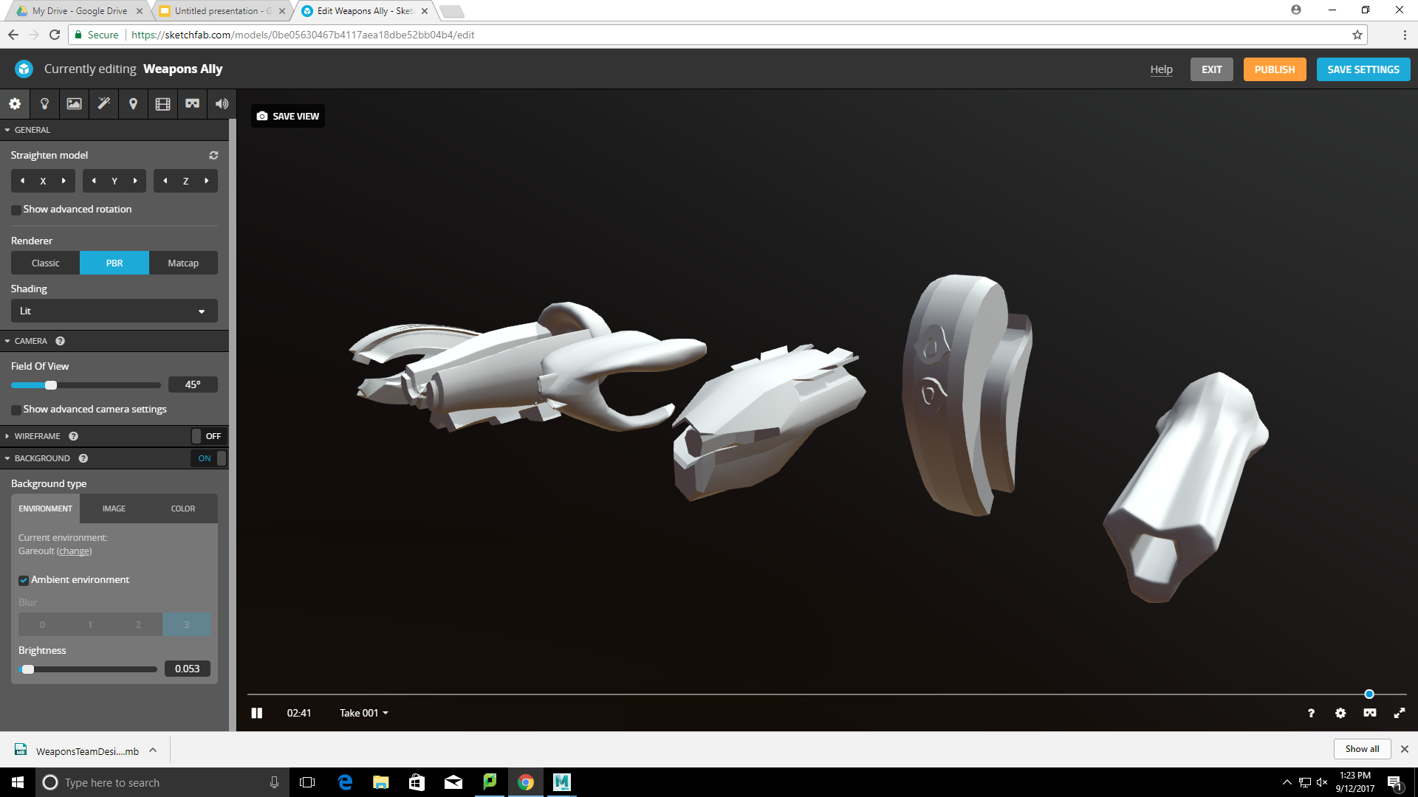
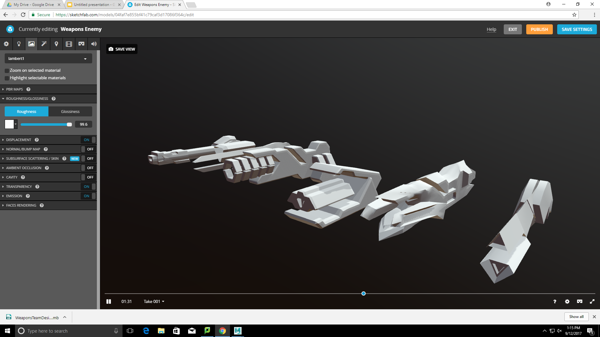
ALLY WEAPONS
Sketchfab Link
ENEMY WEAPONS
Sketchfab Link

Slide 26
HANDS & FEET

Slide 27
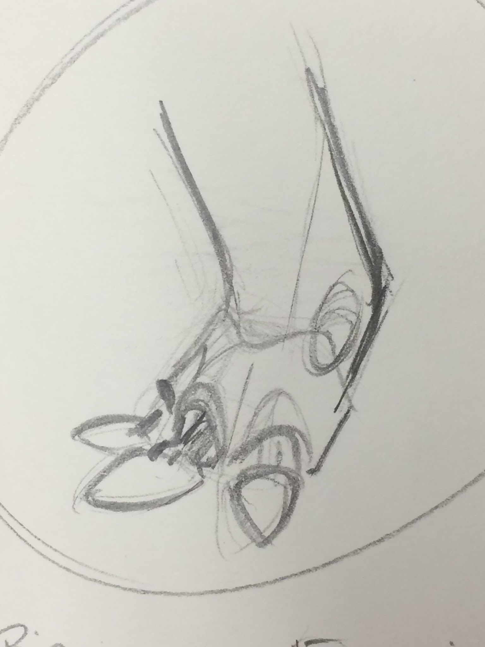
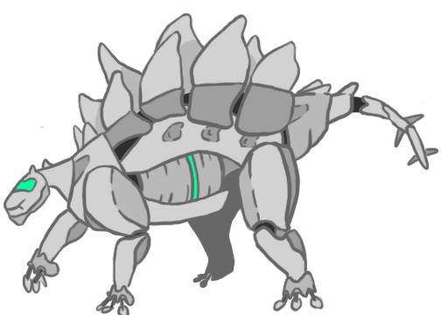
Drawing by Justin Klosinski

Slide 28
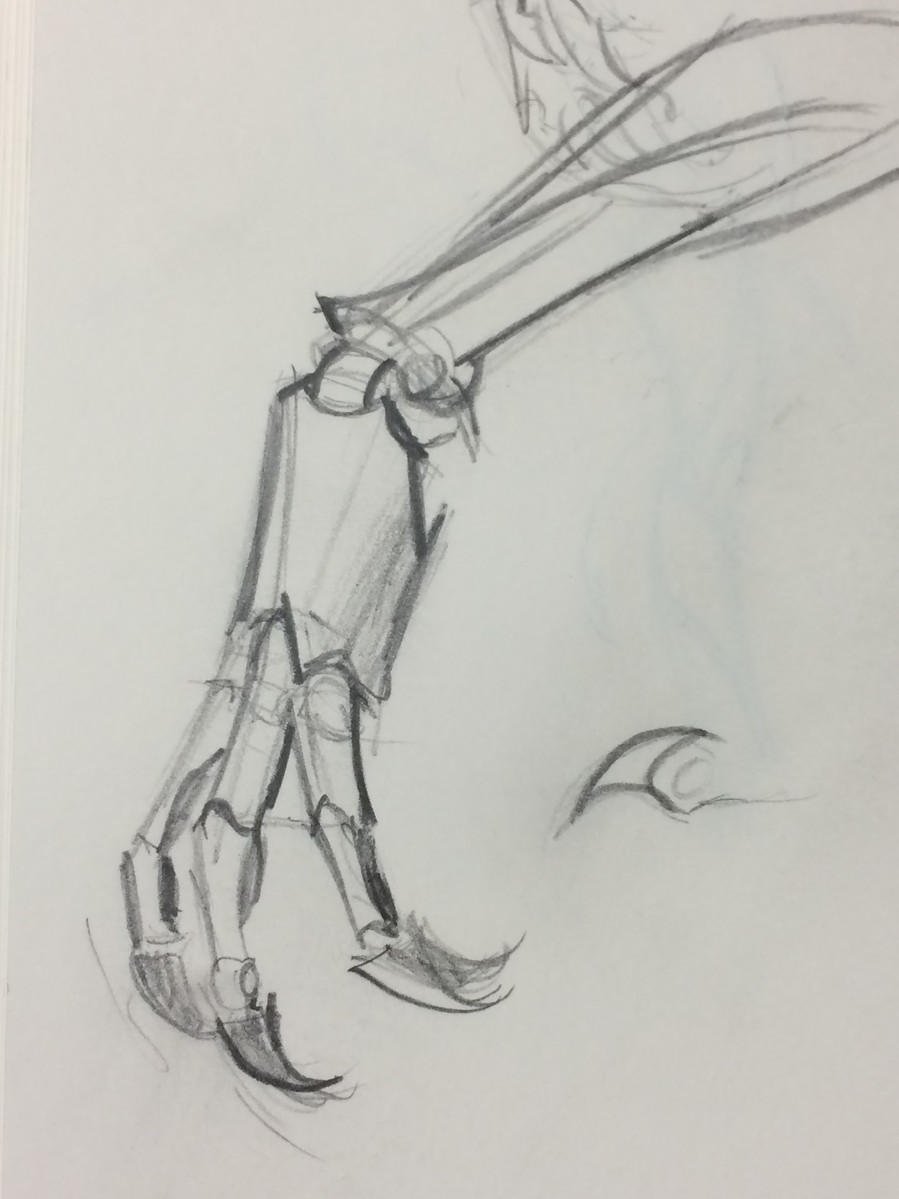
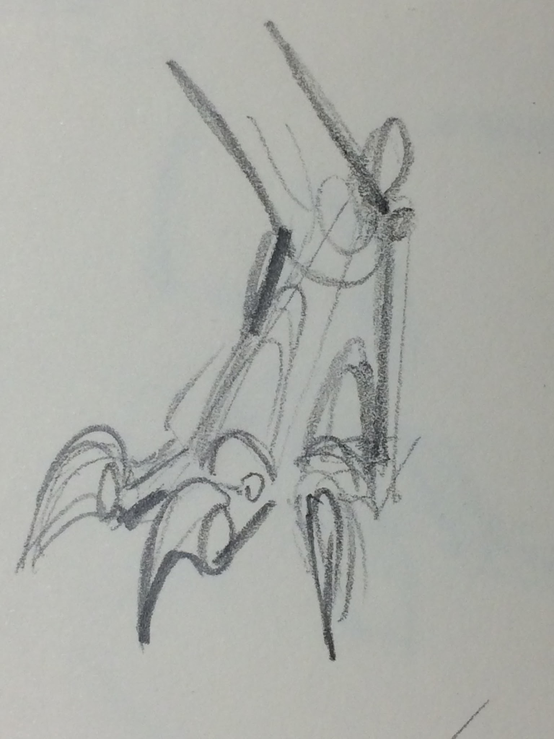

Slide 29
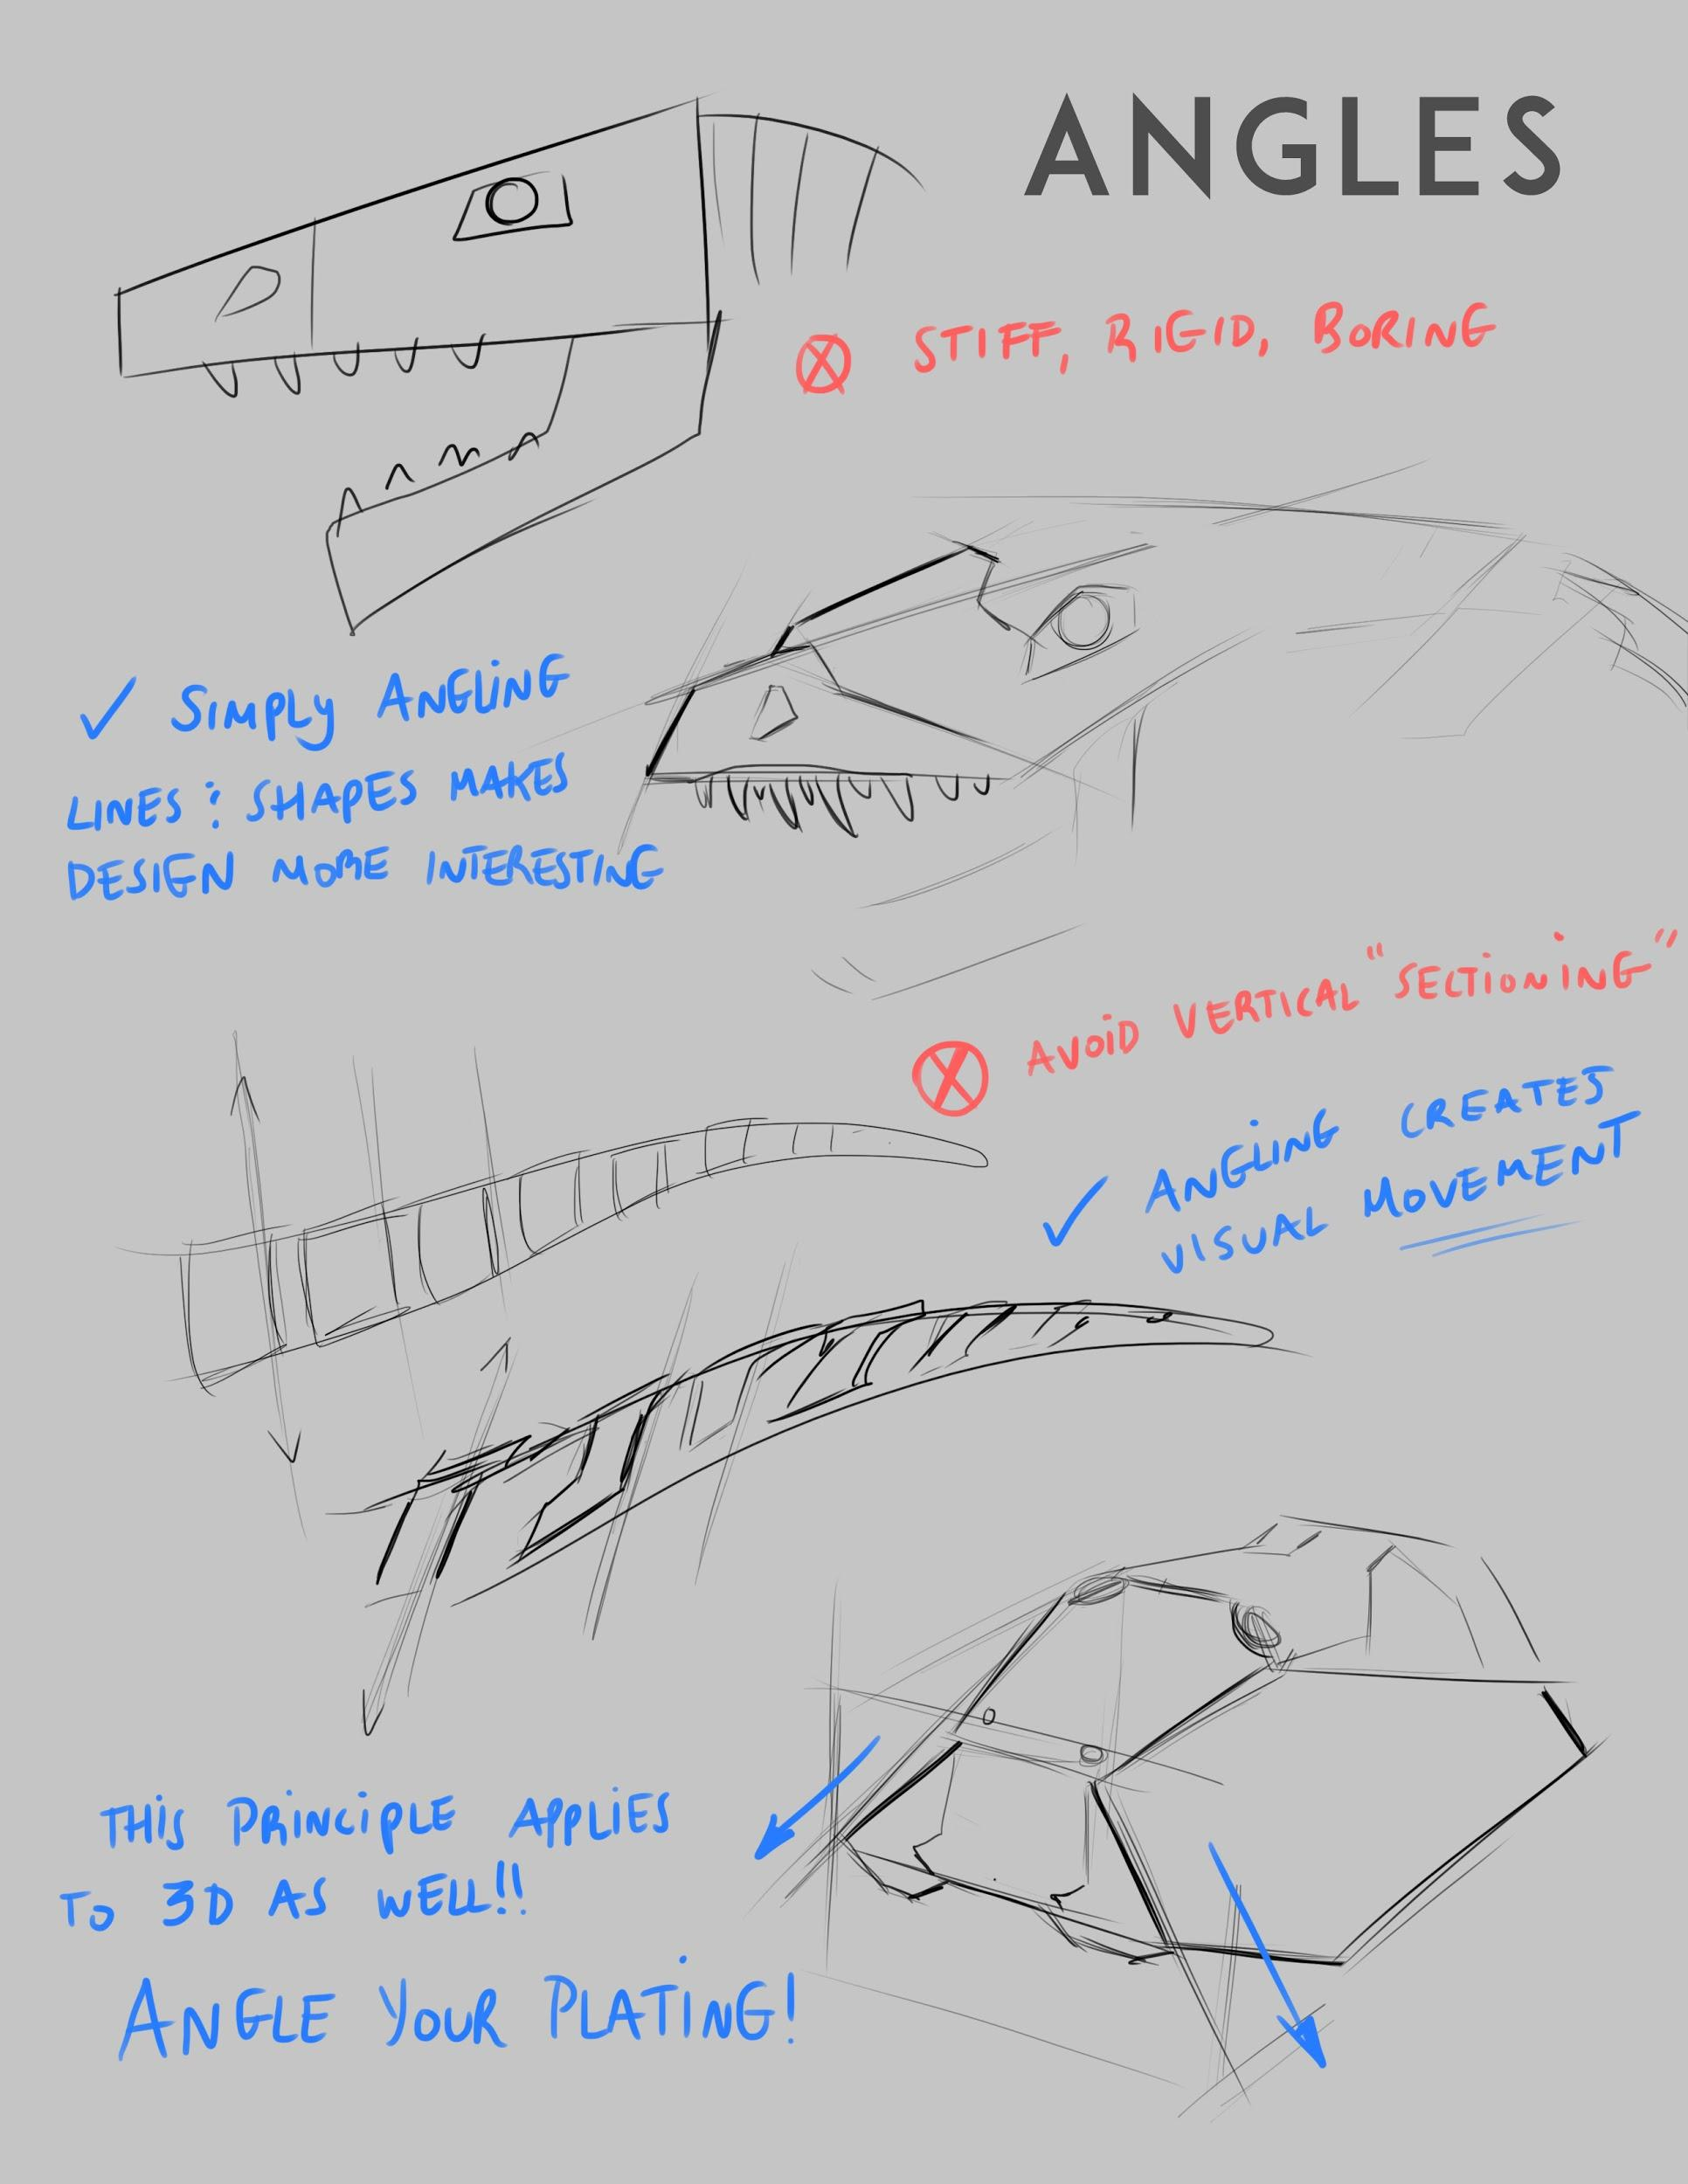
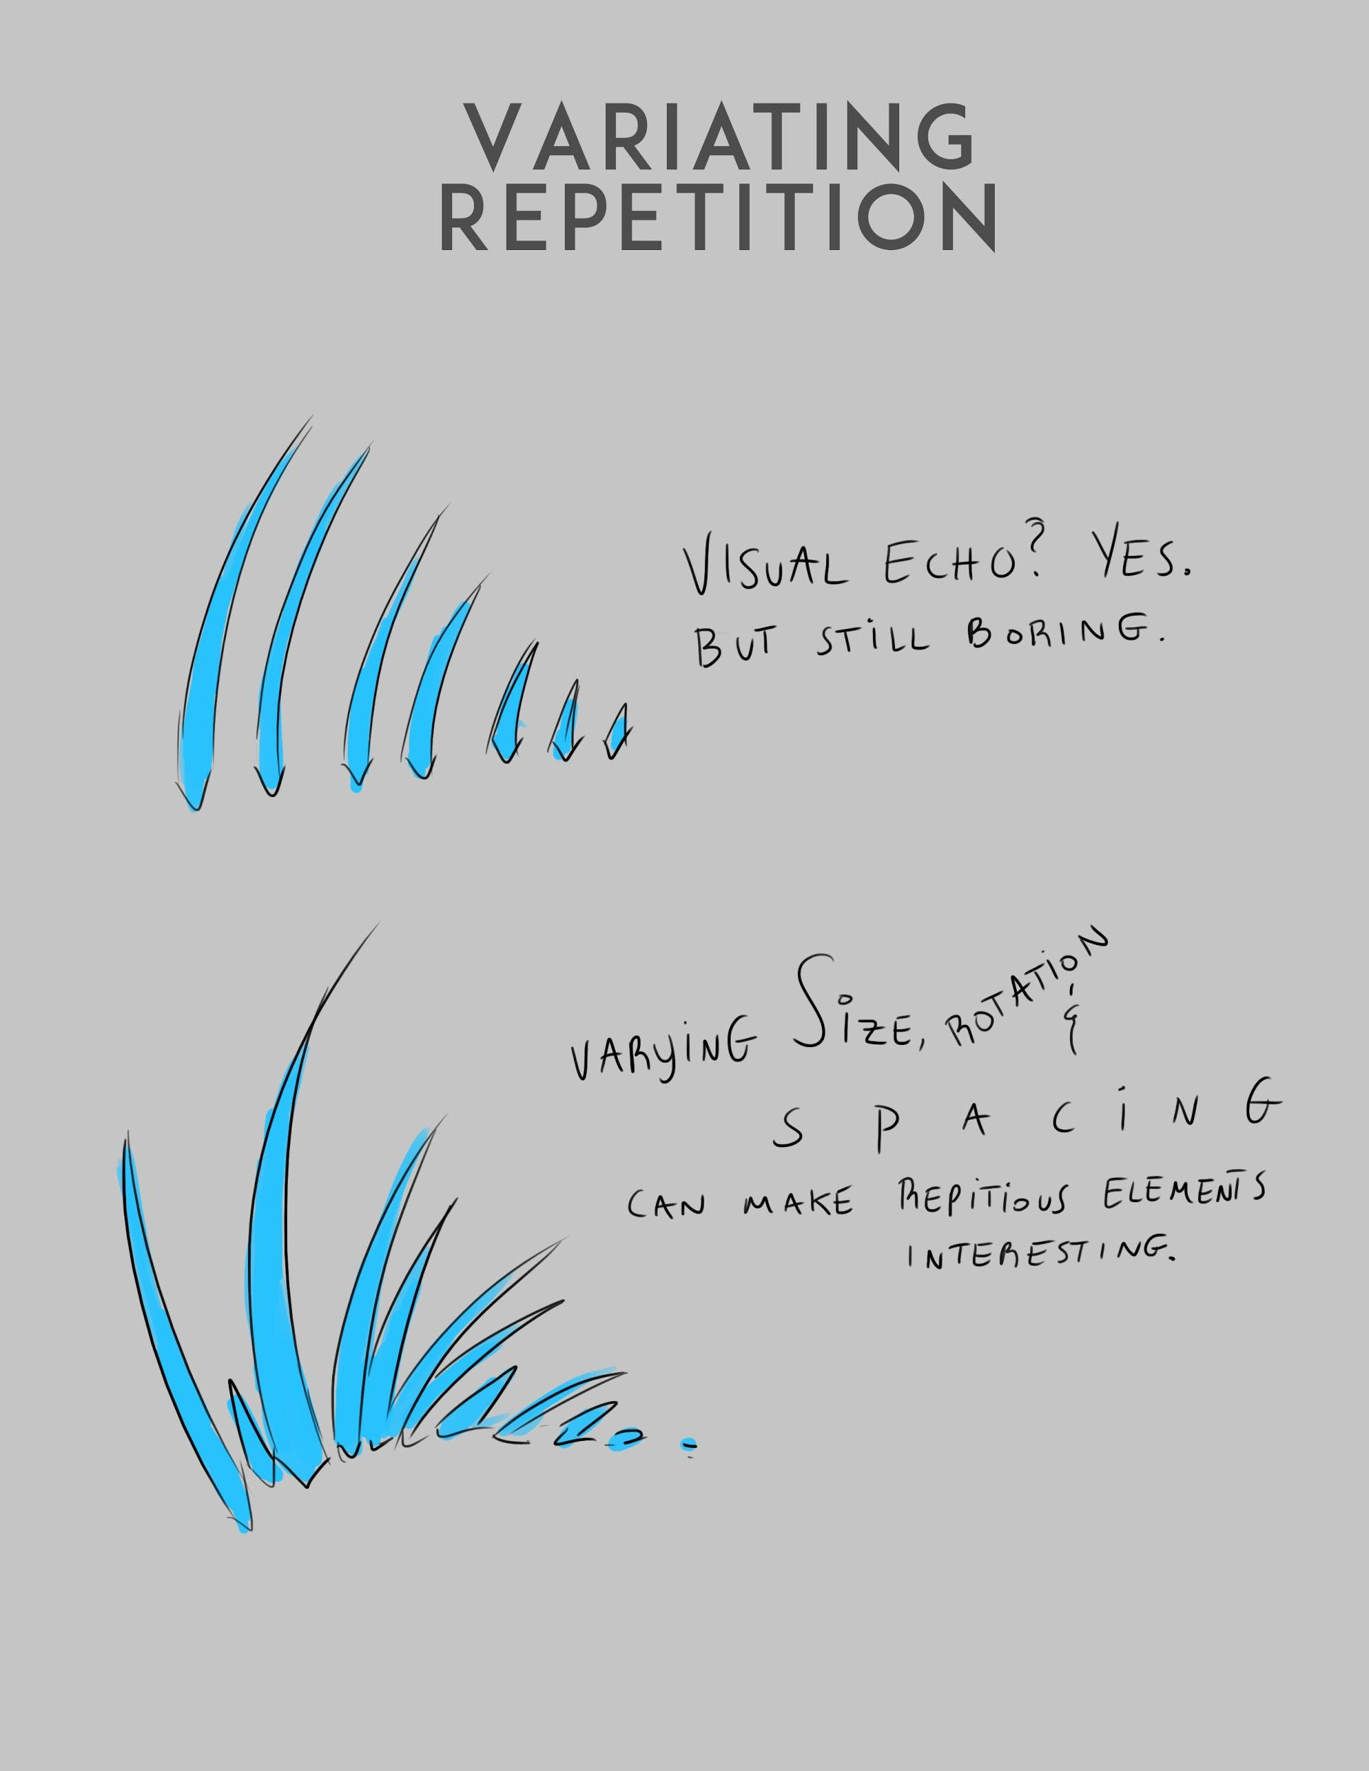
Appendix A - Design

